Slide 1
Huddle Boards – Staff Engagement
Presented To: Board Quality
Presented By: Brian Smith, VP Clinical Services

Slide 2
Huddles Help Connect the Dots:
Strategic Priorities
Huddle Ticket Improvements
Mission/ Vision/ Values
Notes:
Will be assigning MRP’s and timelines

Slide 3
Huddles Help Connect the Dots:
Strategic Priorities
Excellent Experience
Mission/Vision/Values
Person-centered care
Dignity, inclusion, accountability & collaboration
Huddles
Engage staff, patients, physicians
Quality improvements
Meet Community Needs
Support & Empower our people
Future sustainability
Leading community healthcare organization
Patient care, workflow, worklife, environment

Slide 4
Purpose:
To Engage Staff, Physicians, Patients and Family in structured problem-solving
Improve workflow, environment, safety and patient care
Provides a standardized approach to problem-solving
Creates transparency
Gives staff a voice
Fosters collaboration and teamwork
Notes:
Will be assigning MRP’s and timelines

Slide 5
Mechanics:
Gather the team around the Huddle Board
Review the Purpose
Introduce Observers/Guests
Ask if there are any safety concerns
Managers need to be prepared:
Familiar with new tickets
Review updates and work that is in progress
Choose only 1-2 tickets to work on at huddles
Facilitate moving the ticket forward
Notes:
Will be assigning MRP’s and timelines

Slide 6
Mechanics:
Managers choose a ticket
Use the pick-chart to prioritize the ticket
Some tickets are kiboshed
Does not mean it is not a good idea
Review work in progress – PDSA problem solve, 3rd Party Action or Escalation
Facilitate problem solving
Review completed tickets
Share KUDOS! ☺

Slide 7

Facilitate Dialogue
Huddle is about harnessing everyone’s best thinking to solve a problem or make an improvement
Less telling, more asking!

Slide 8


Huddle Tricks and Tips:
Never remove a ticket from the board.
If the ticket is inappropriate, coach to reframe the problem statement
Huddle is a collaboration

Slide 9
Huddle Tricks and Tips:
Keep time to 15 minutes
5 min safety Huddle when the unit is excessively busy
Communicate new information
Restrict content to current and relevant
Not a bulletin board

Slide 10
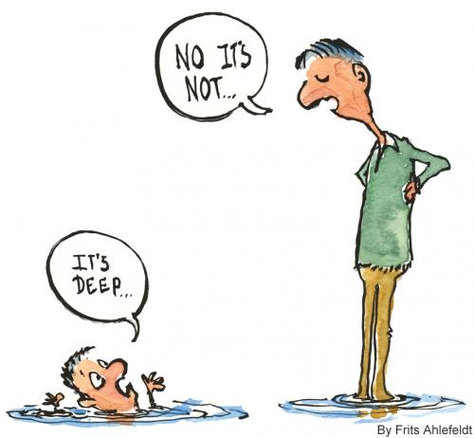
Huddle Tricks and Tips:
Value Every Perspective
Everyone needs to feel heard and validated

Slide 11
Huddle Tricks and Tips:
Empower the team
Say less, ask more
Encourage Experiment
Facilitate the Problem Solving
Make Huddle a daily routine
Be what you want to see (for managers)
Notes:
Embody the change
Actionable responsibility – initiate the change
Help be the change you want to see for the department
Self focus over external change – don’t’ wait for other to try and change - inspire the team to help contribute to the change

Slide 12

Communicate and Celebrate:
End the Huddle on a high note
Remember to celebrate
Recognize team members for their actions and attitudes – be specific
Notes:
Embody the change
Actionable responsibility – initiate the change
Help be the change you want to see for the department
Self focus over external change – don’t’ wait for other to try and change - inspire the team to help contribute to the change

Slide 13
Impactful Tickets - Resolved
Perth:
Structured training for new hires based on recurrent tickets that identified a need for additional training for new staff; consists of consistent buddy for new hires and specific task lists
Smiths Falls:
Video camera outside OBS Unit based on a ticket regarding staff and patient safety after hours and access to the unit
New Ice Machine on the Med/Surg Unit based on an identified equipment need

Slide 14
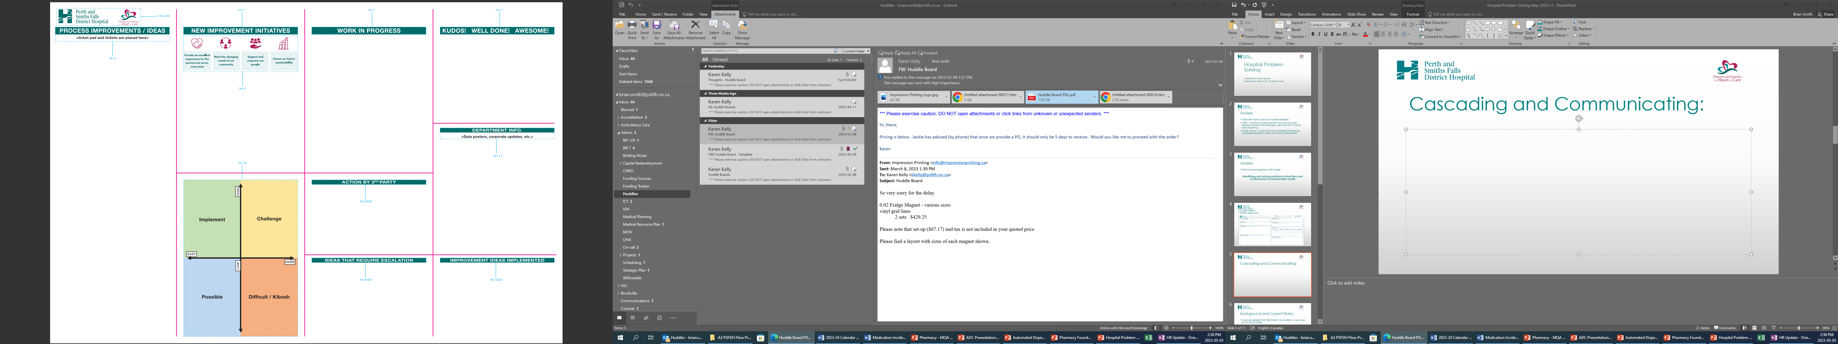
Cascading and Communicating:

Slide 15
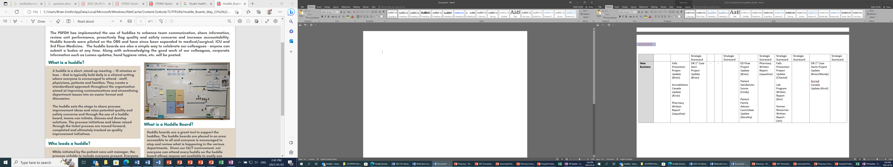
Huddle Boards:

Slide 16
Huddles:
By using creative problem solving, Leaders, Staff, Physicians and Patient and Families are able to take challenging situations and turn them into well-defined problems with an action plan
Notes:
Will be assigning MRP’s and timelines

Slide 17


